Slide 1
NES Project – Task 1 Basic Rendering
Daniel José Febles Bustillo

Slide 2
Objectives
Briefly resume the structure of the code and its initiation
Explain the data being used for the rendering
Describe how the foreground sprites are allocated in memory
Describe how background tiles are written to the nametable
Show the results of the process

Slide 3
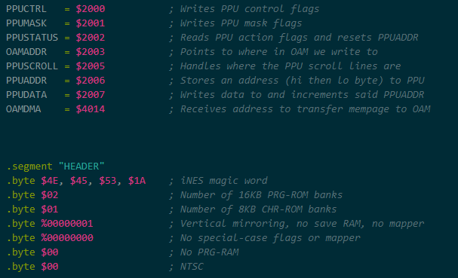
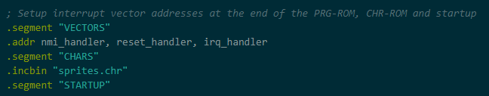
Code Structure
7 sections – CONSTANTS, HEADER, RODATA, CODE, VECTORS, CHARS, STARTUP
CONSTANTS and STARTUP are references for the IDE
HEADER and VECTORS are part of the ROM setup so that it runs correctly
CHARS is everything related to graphics data
RODATA and CODE are the most important parts of the code concerning logic, particularly CODE
Both of the aforementioned sections divide into various parts, the most important ones for each are the “sprites” table and the “main” proc respectively.

Slide 4
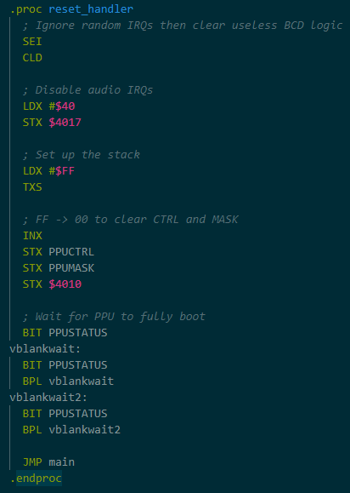
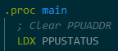
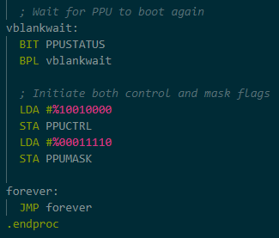
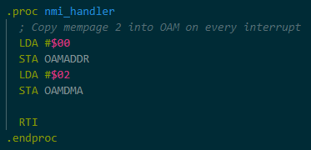
Initiation Adjustments
The reset handler initiates and cleans necessary data like the stack the PPU flags, then waits for the PPU to fully boot
The NMI handler reserves a page of memory (256 bytes) to move to OAM
The main code starts by clearing the PPU address latch and ends by raising the corresponding flags for PPUCTRL and PPU mask, before beginning the game loop

Slide 5
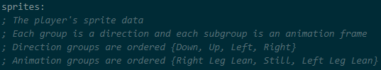
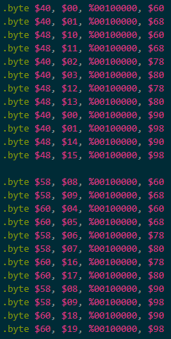
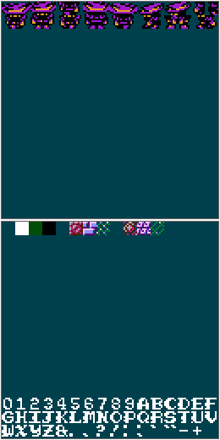
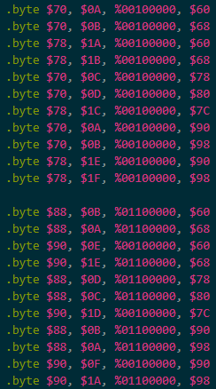
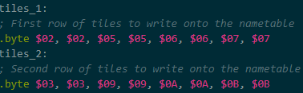
Sprite Context
As an exercise, I simply focused for this task how to work with the PPU from scratch and leave subroutines for the next task
There are three tables in RODATA, one for OAM sprites y two for nametable tiles
The sprite table is composed of various groups of 4-byte sets
The 4 bytes represent Y-pos, ID, flags, and X-pos respectively
Each group associates with a given direction, and each subgroup associates with a given animation frame
The two tile tables are written twice to create metatiles (2x2 tiles)

Slide 6
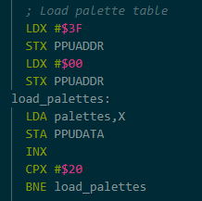
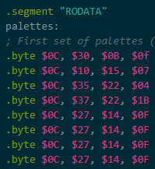
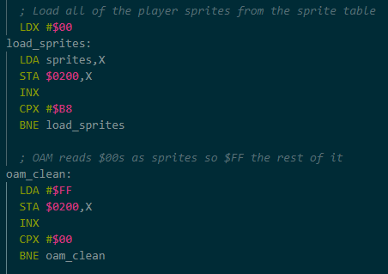
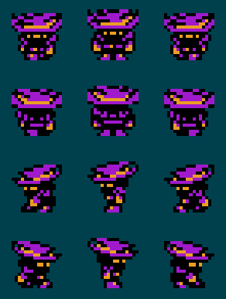
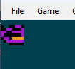
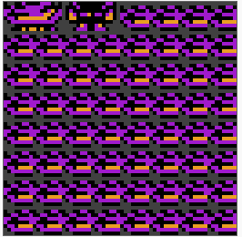
Sprite Display
First, prepare the colors by writing to the PPU palette address through PPUDATA, using a table of stored values in RODATA
With the colors ready, the OAM reserved page is filled with all the values present in the player’s sprites table, with a simple loop
The rest of the table is also filled with $FF (hex 255) to prevent a particular scenario where various copies of the first sprite appear in the upper left corner
This is because all of the contents of the OAM are read as valid data, even the parts of the page that the programmer doesn’t write to

Slide 7
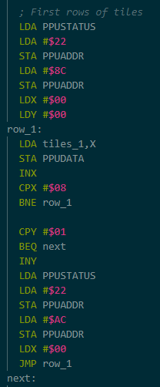
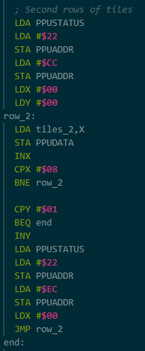
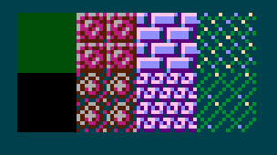
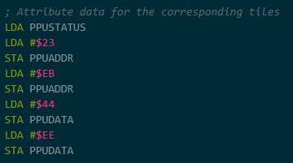
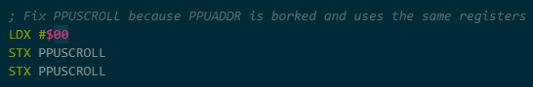
Tile Writing
Build two similar loops for both tile tables
Before initiating the loop, load the address of where to start writing in the nametable
Afterwards, write in PPUDATA the respective table’s content
A flag is raised, and we write to the row below the one that was just written.
At the end of the loop, the raised flag indicates that both rows were written, and we can move onto the next part
At the end, add two attributes to PPUADDR
Attributes are basically nametable color

Slide 8
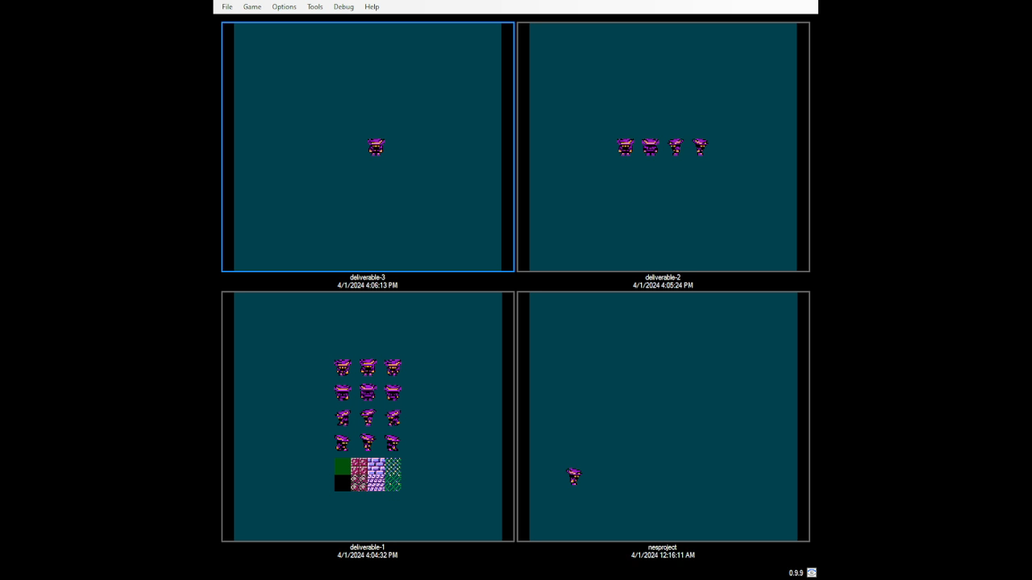
Final Result

Slide 9
Thank you for your attention

